Slide 1
Gender Data of Street Names in 30 European Cities
Moira Campbell

Slide 2
Introduction
What are the demographics of streets named after people in Europe? What is the gender distribution?

Slide 3
The Data
Mapping Diversity project
A set of 145,933 streets across 30 European cities across 17 countries.
Demographic information and naming information included in the sheet.
Despite the large number of streets, ultimately a small sample size across countries (there are 44 countries in Europe).

Slide 4
Data Cleaning
The data is provided as a fairly tidy sheet, so cleaning is mostly a matter of curation and sorting.
Cleaning performed in Clojure via its robust data processing functions.

Slide 5
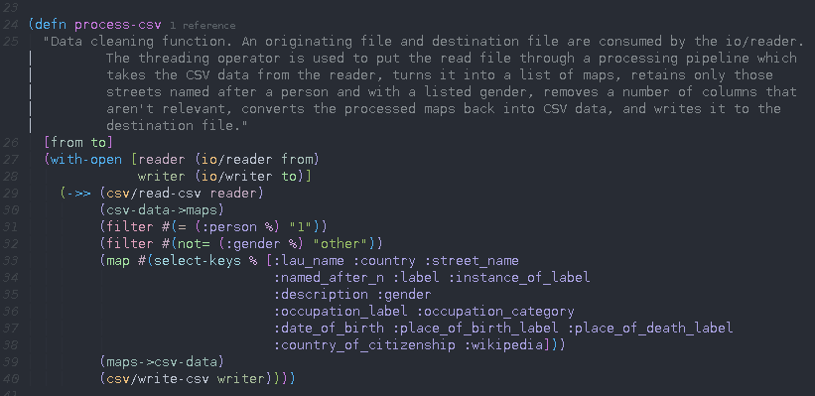
Code sample

Slide 6
Analysis
Cleaned CSV is imported into R and explored.
It is arranged in various ways and given a number of visualizations using ggplot.

Slide 7
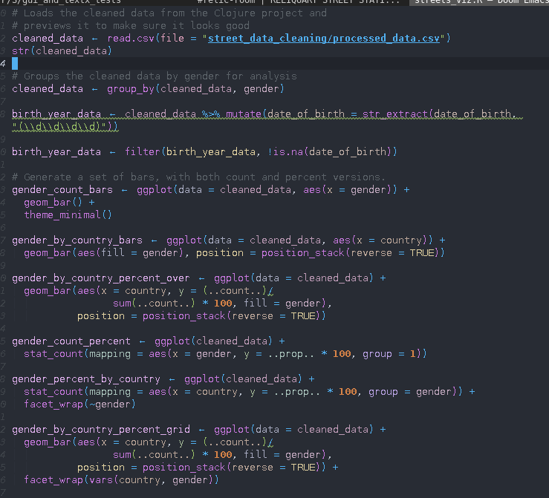
Code sample

Slide 8
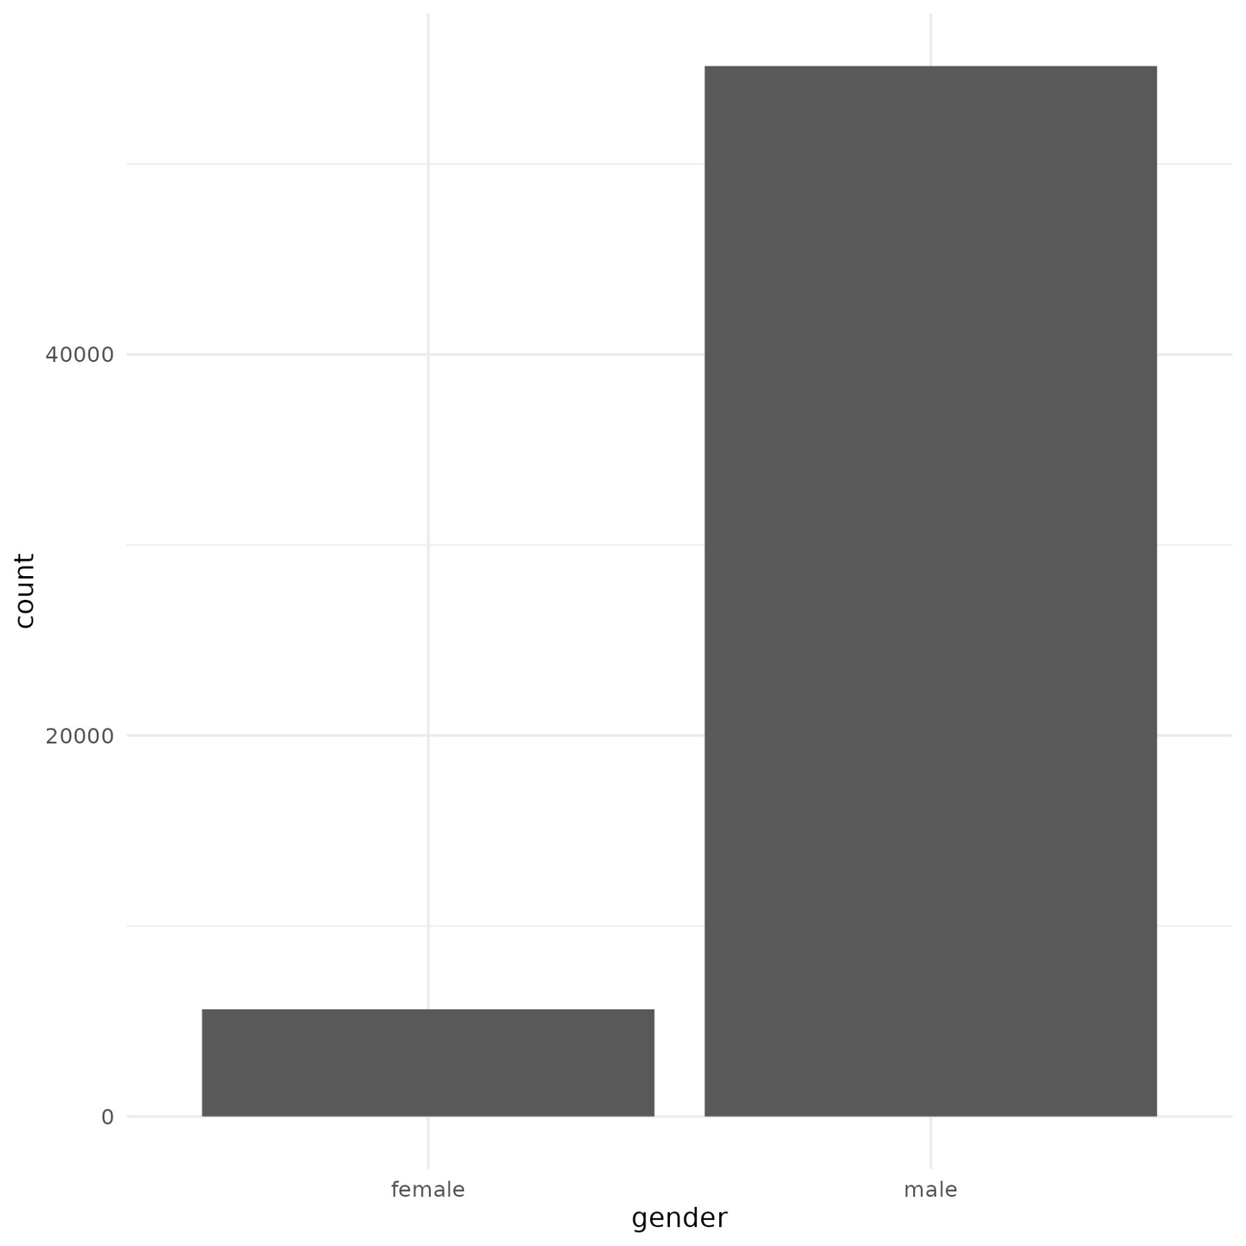
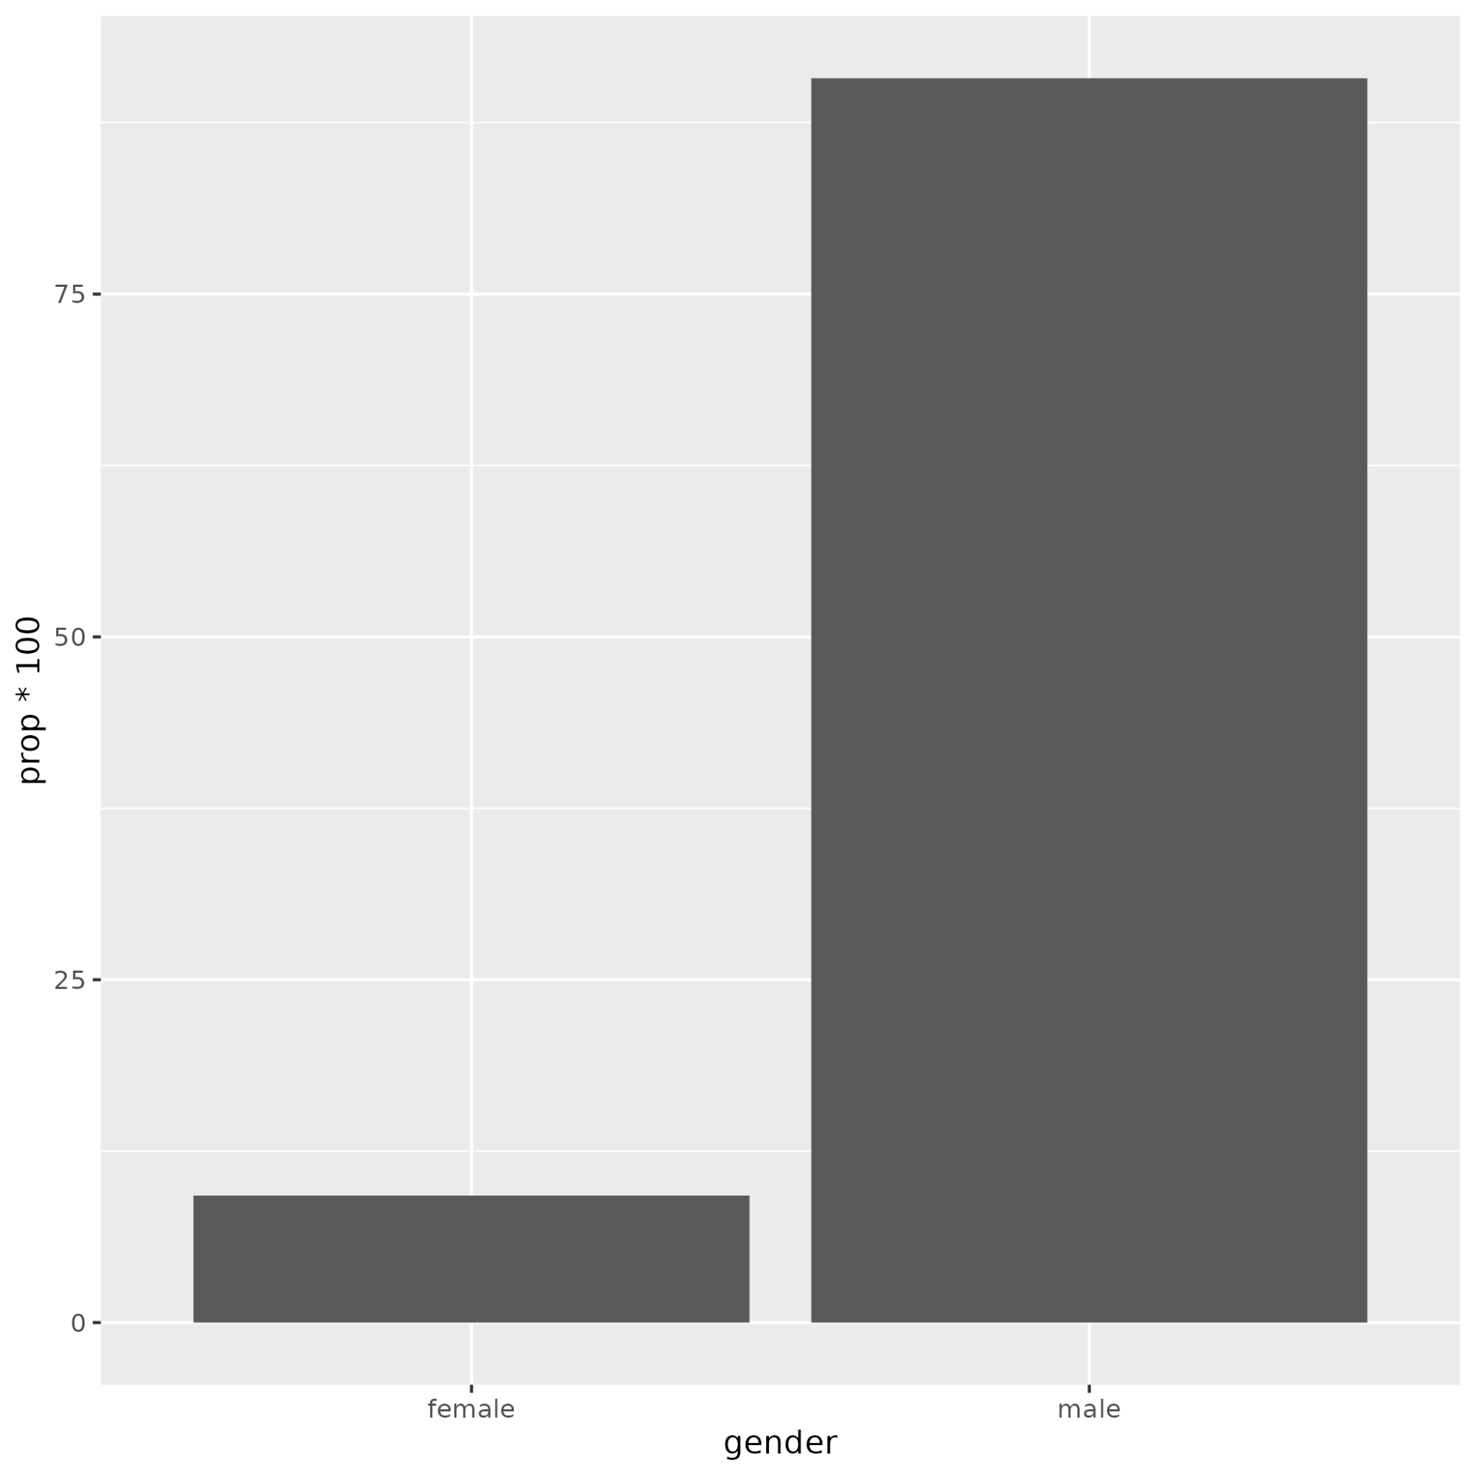
Behold, visualizations

Slide 9
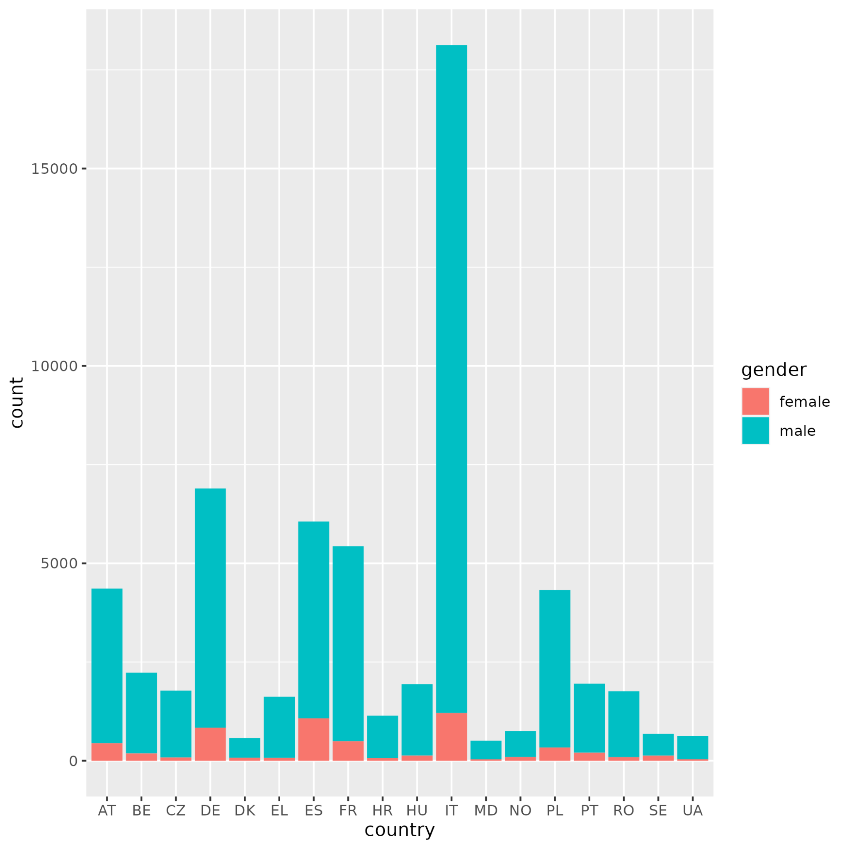
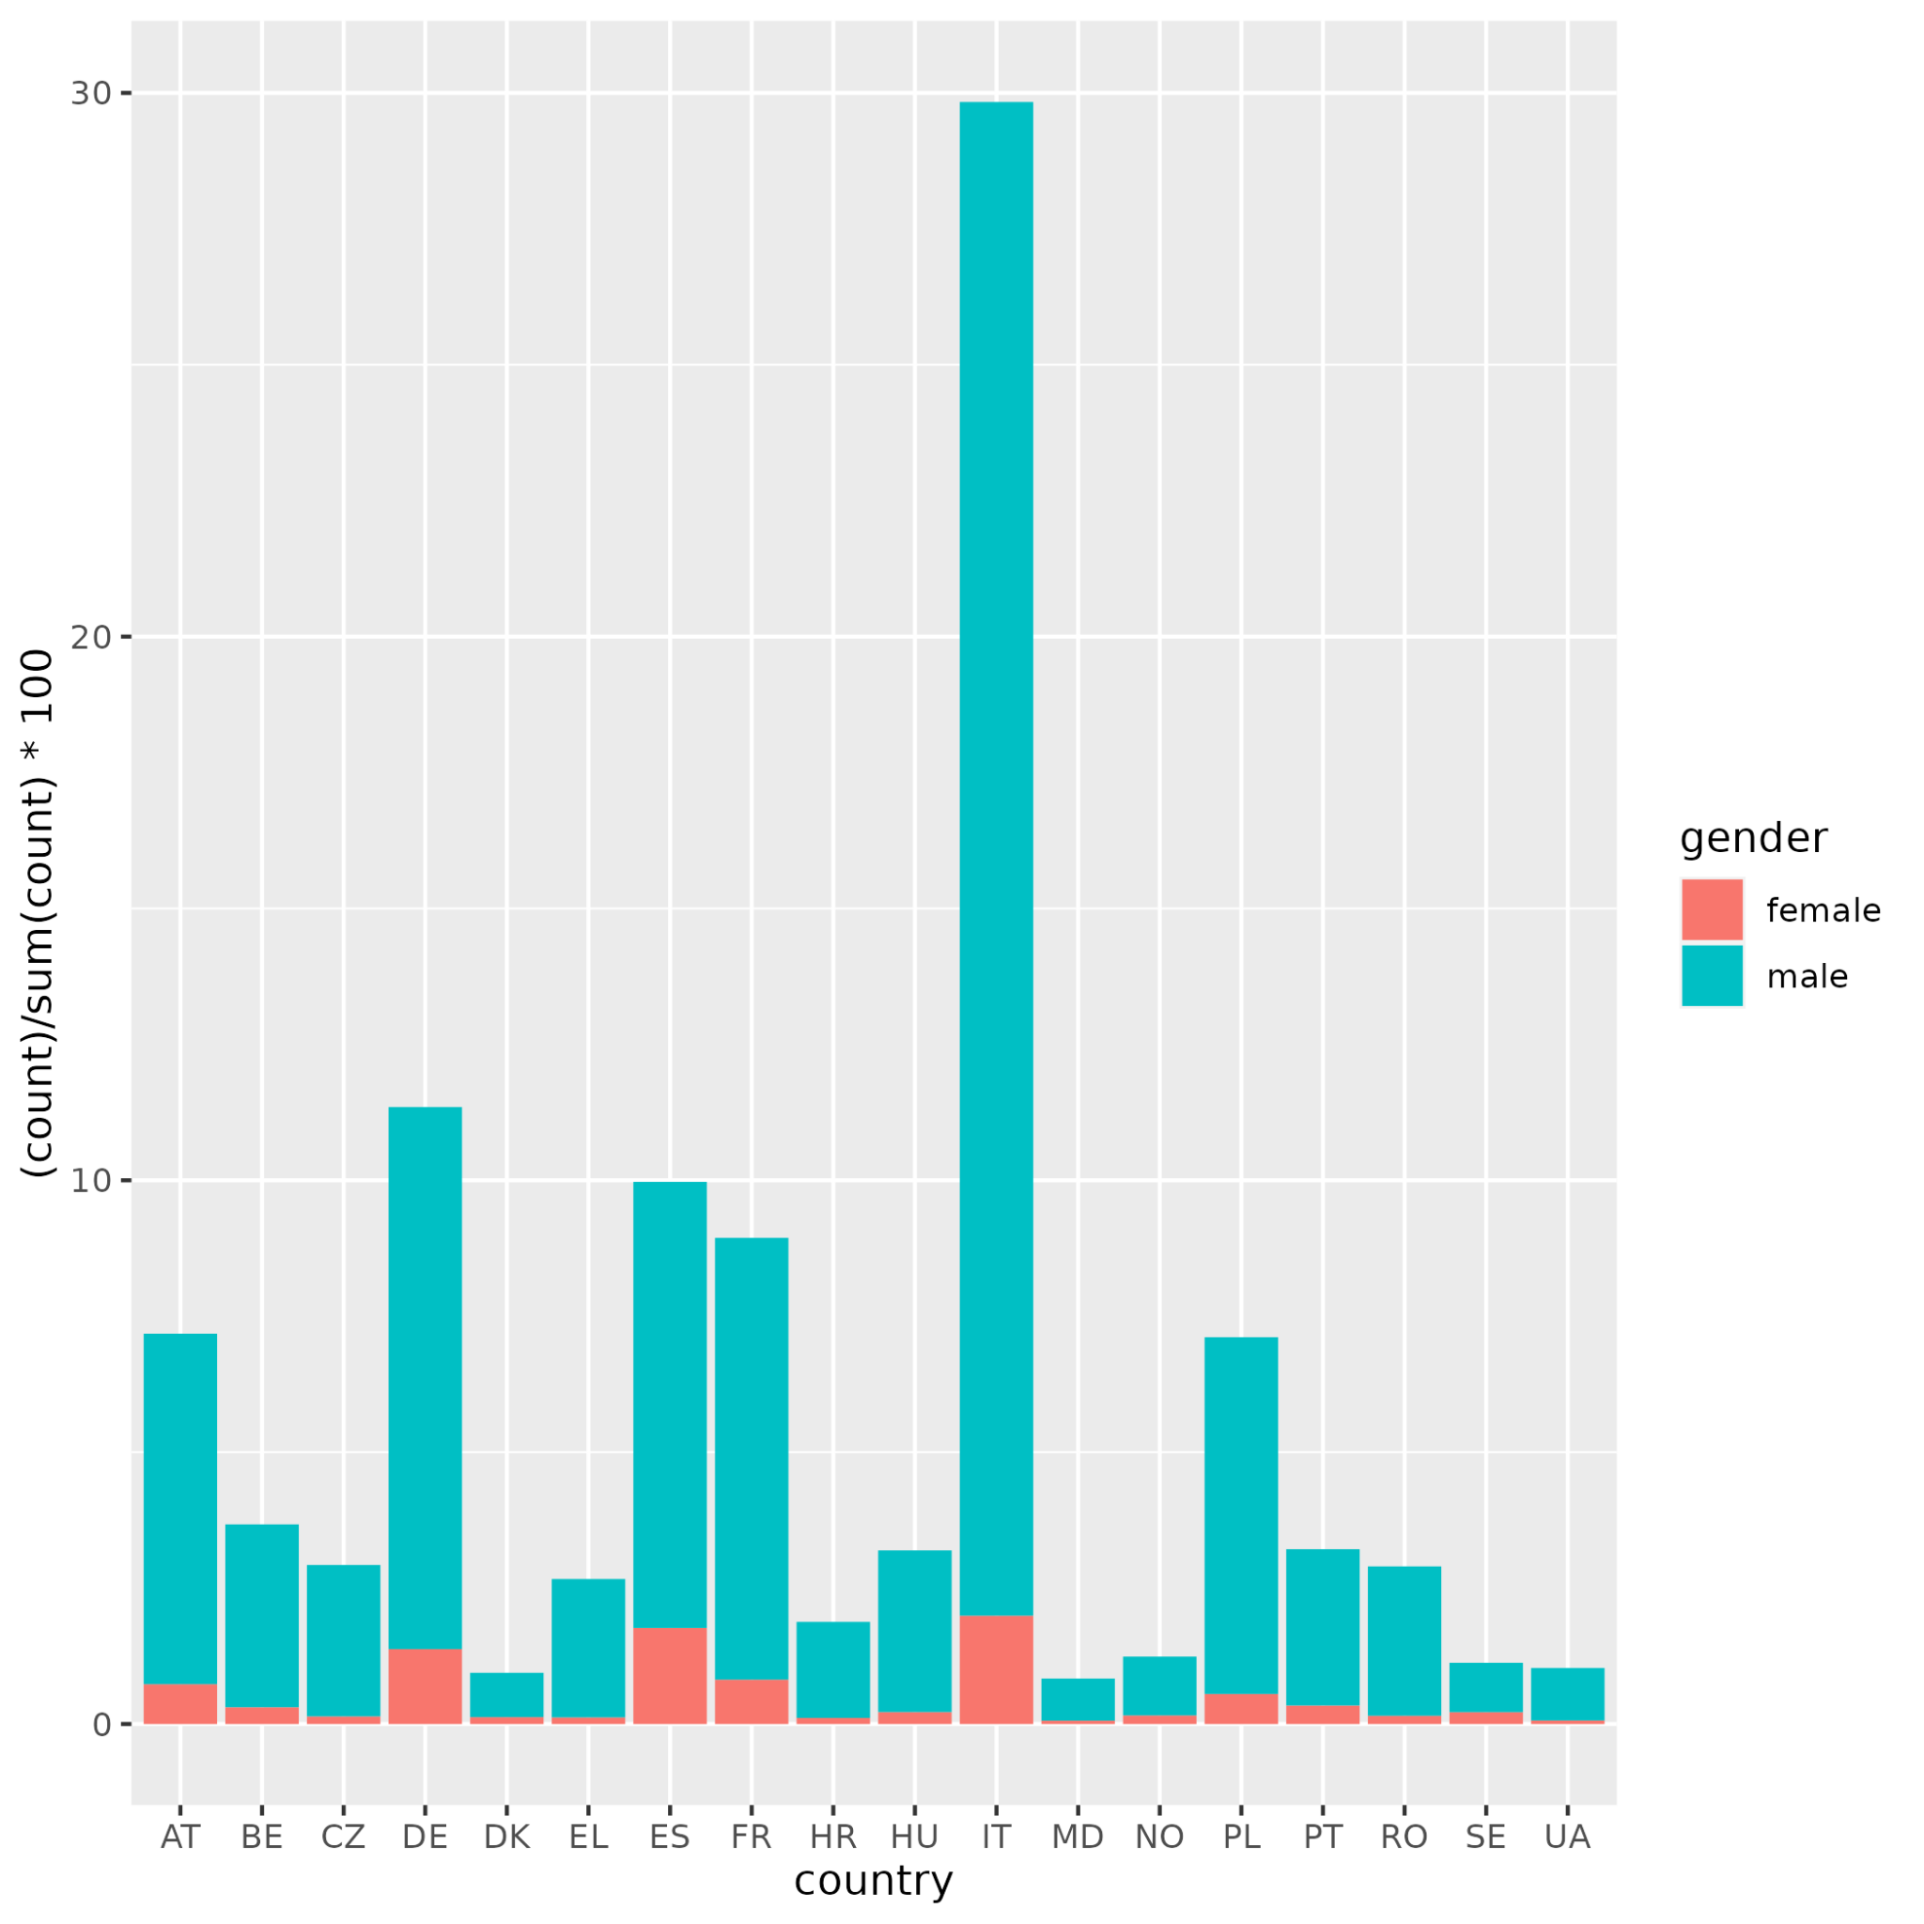

Slide 10
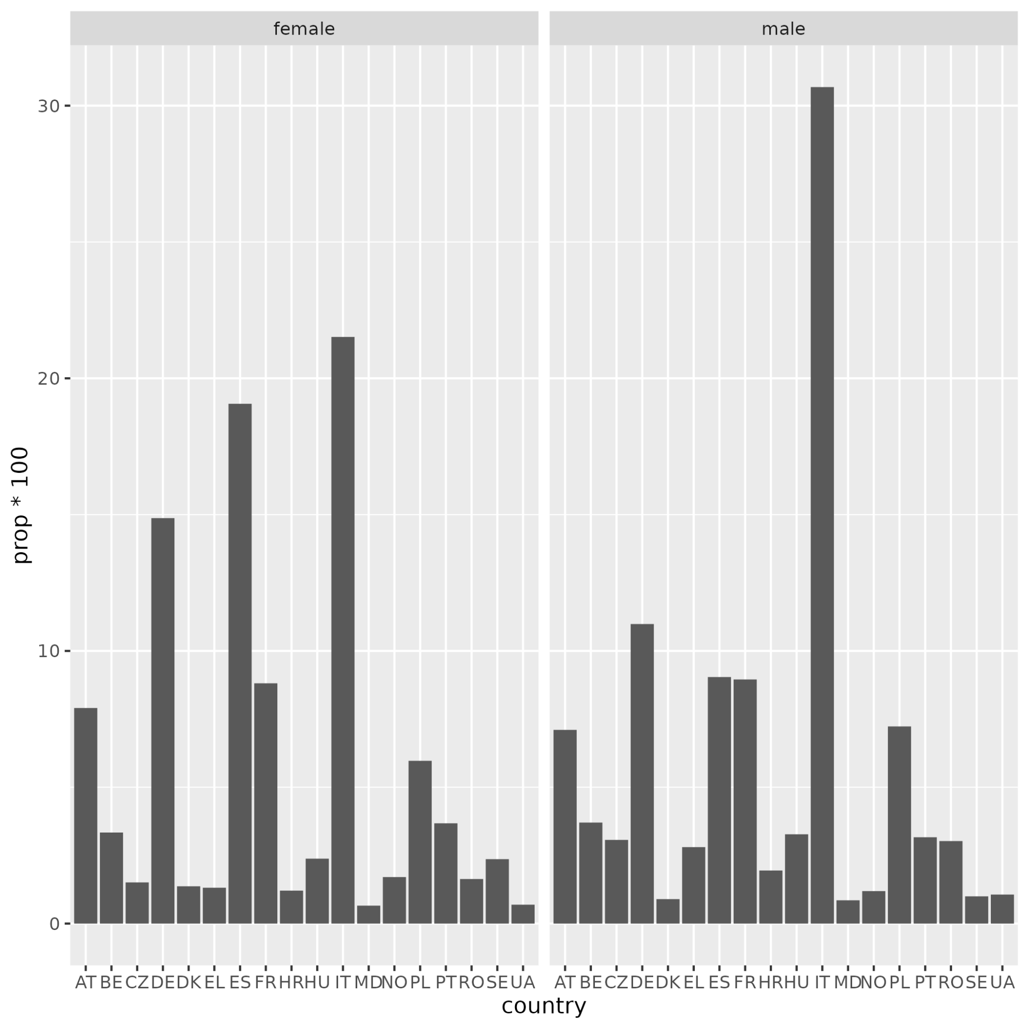

Slide 11
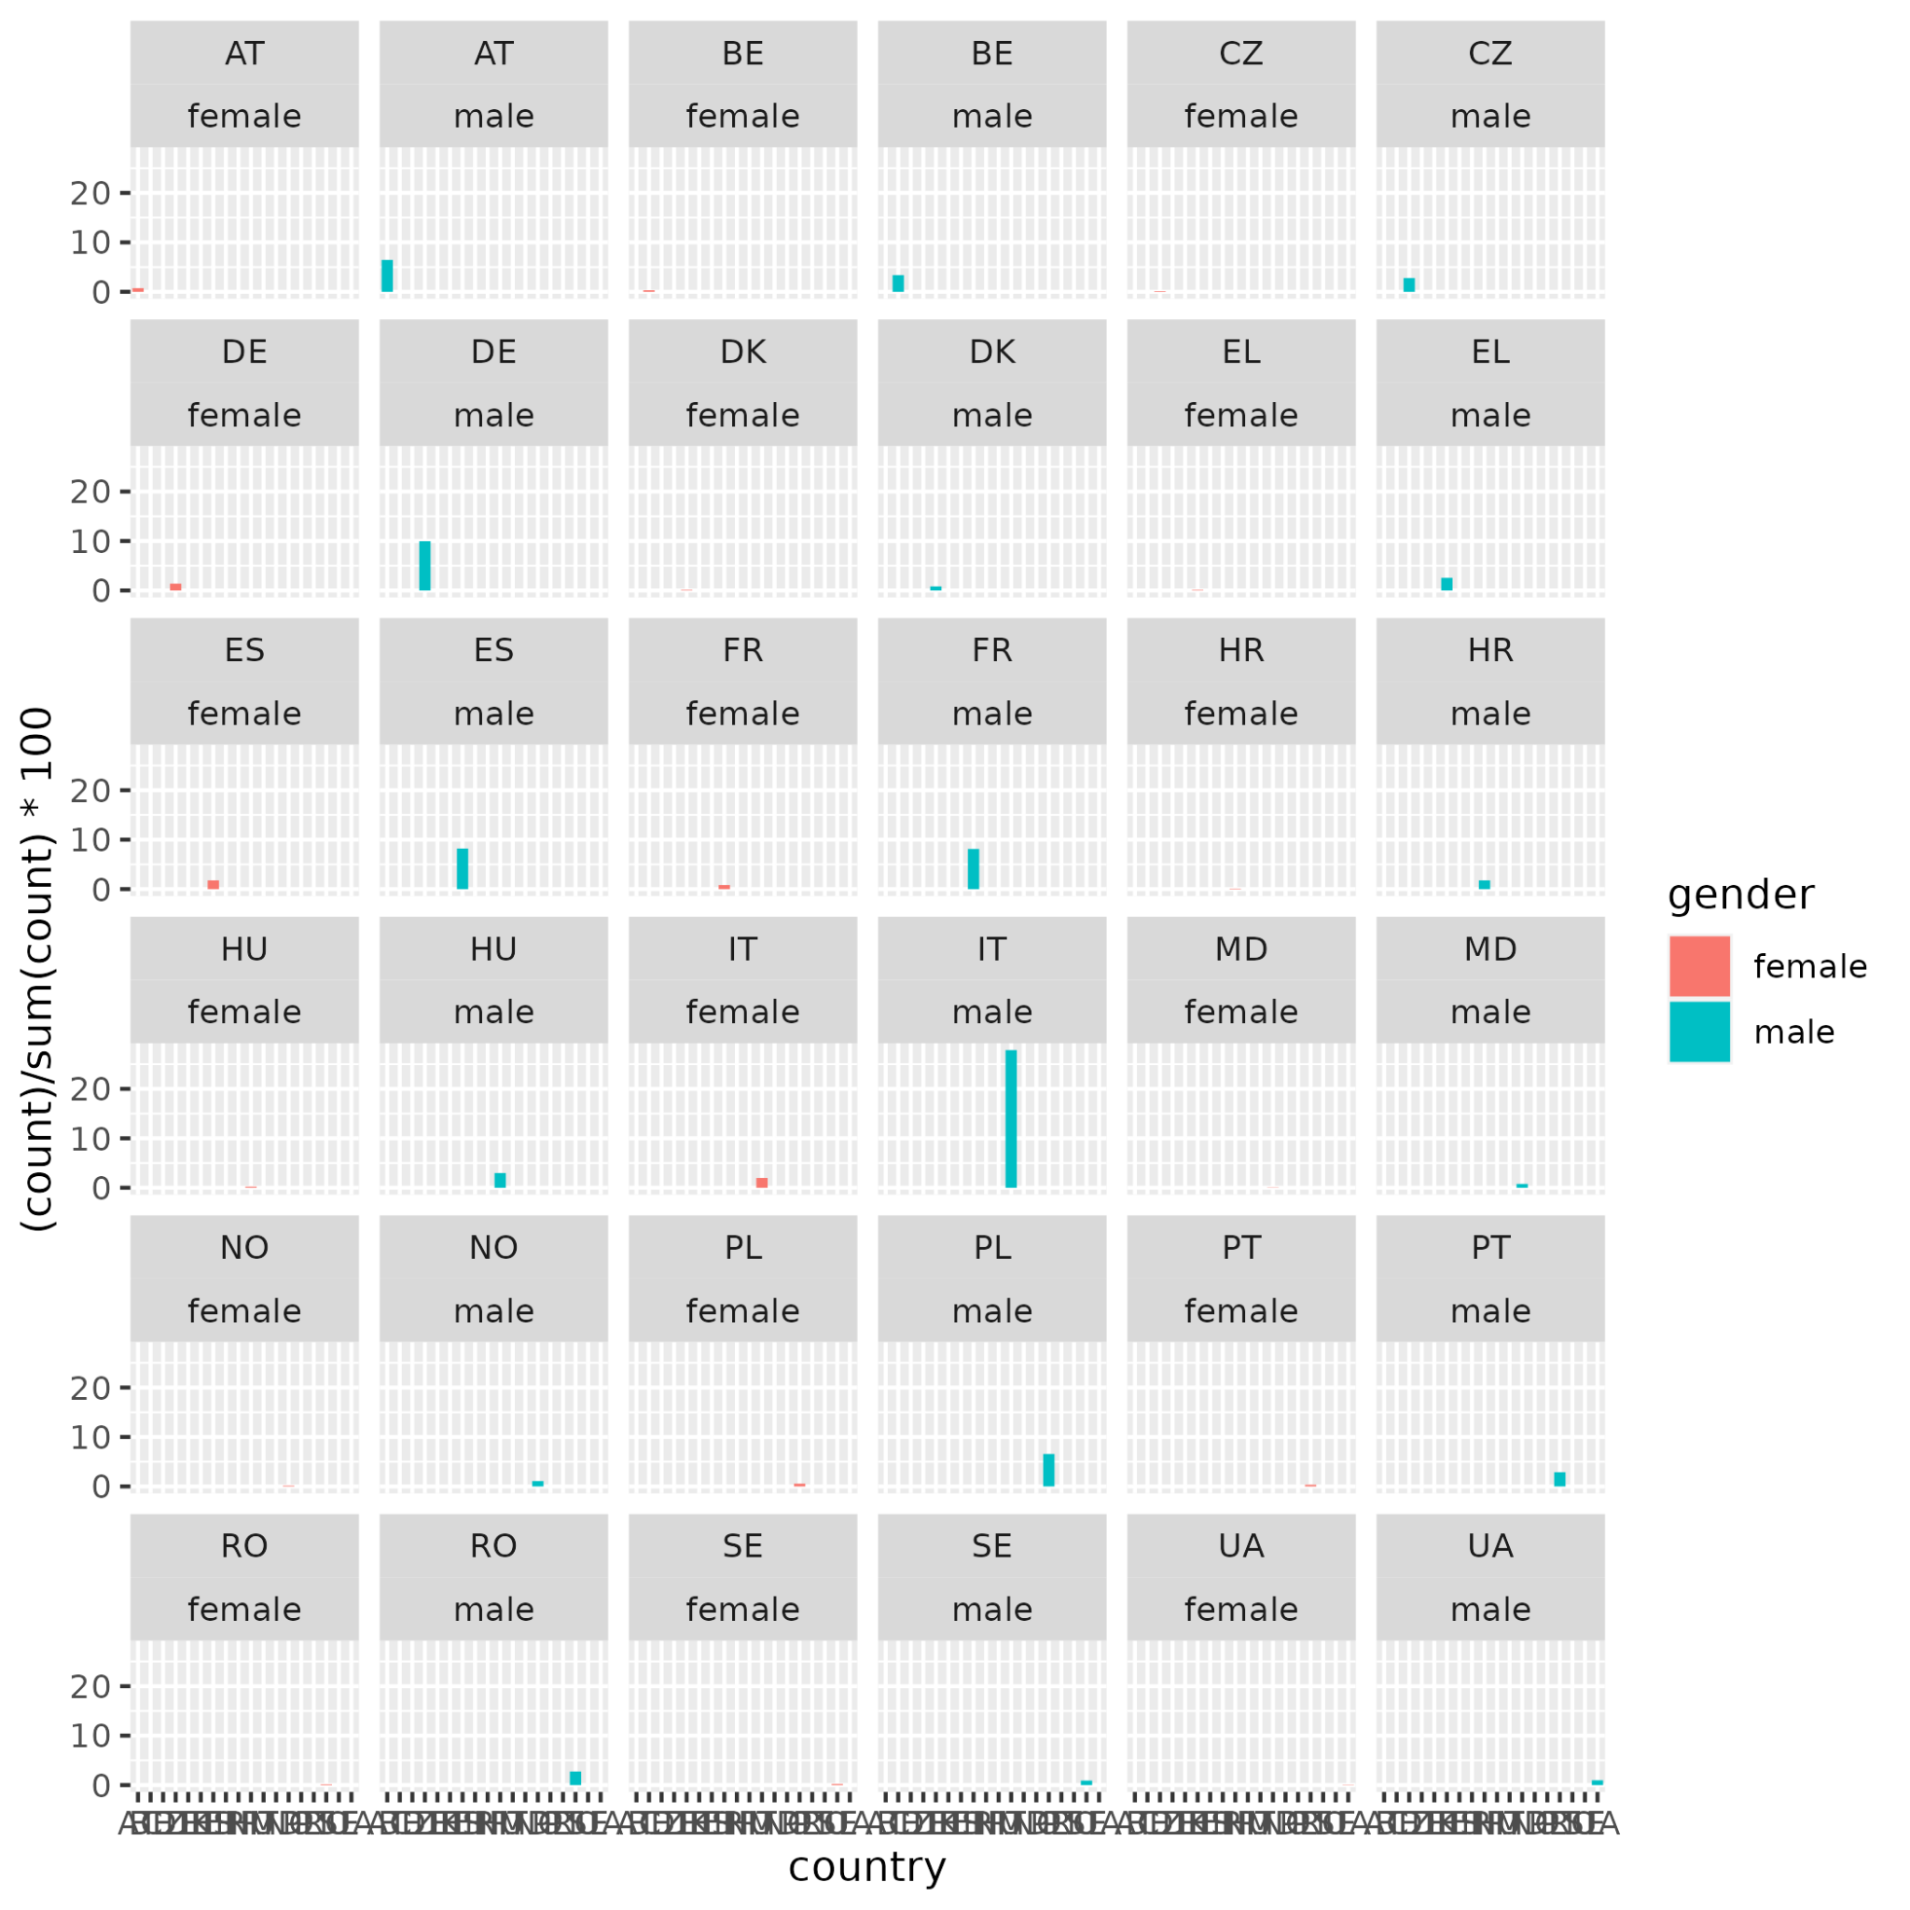

Slide 12
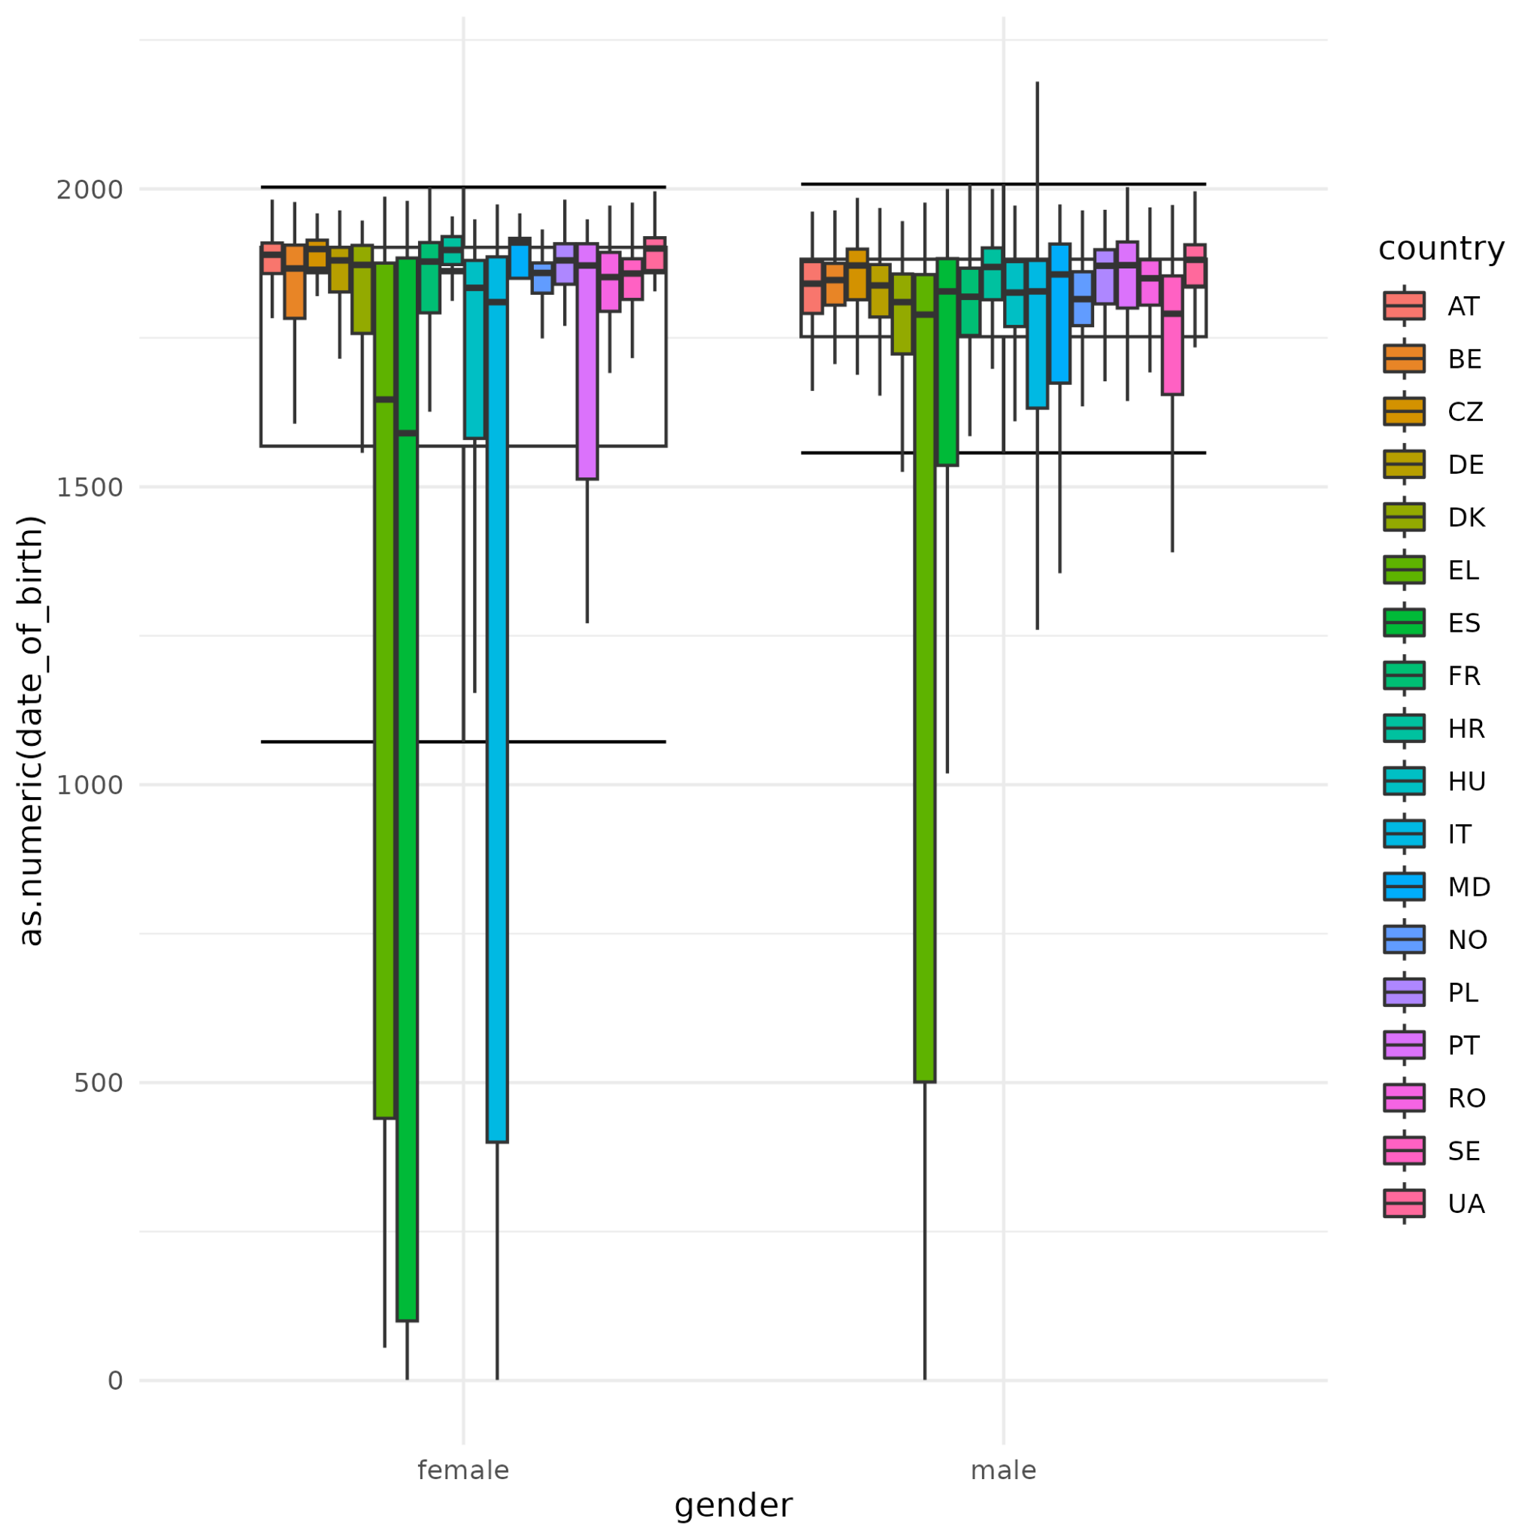
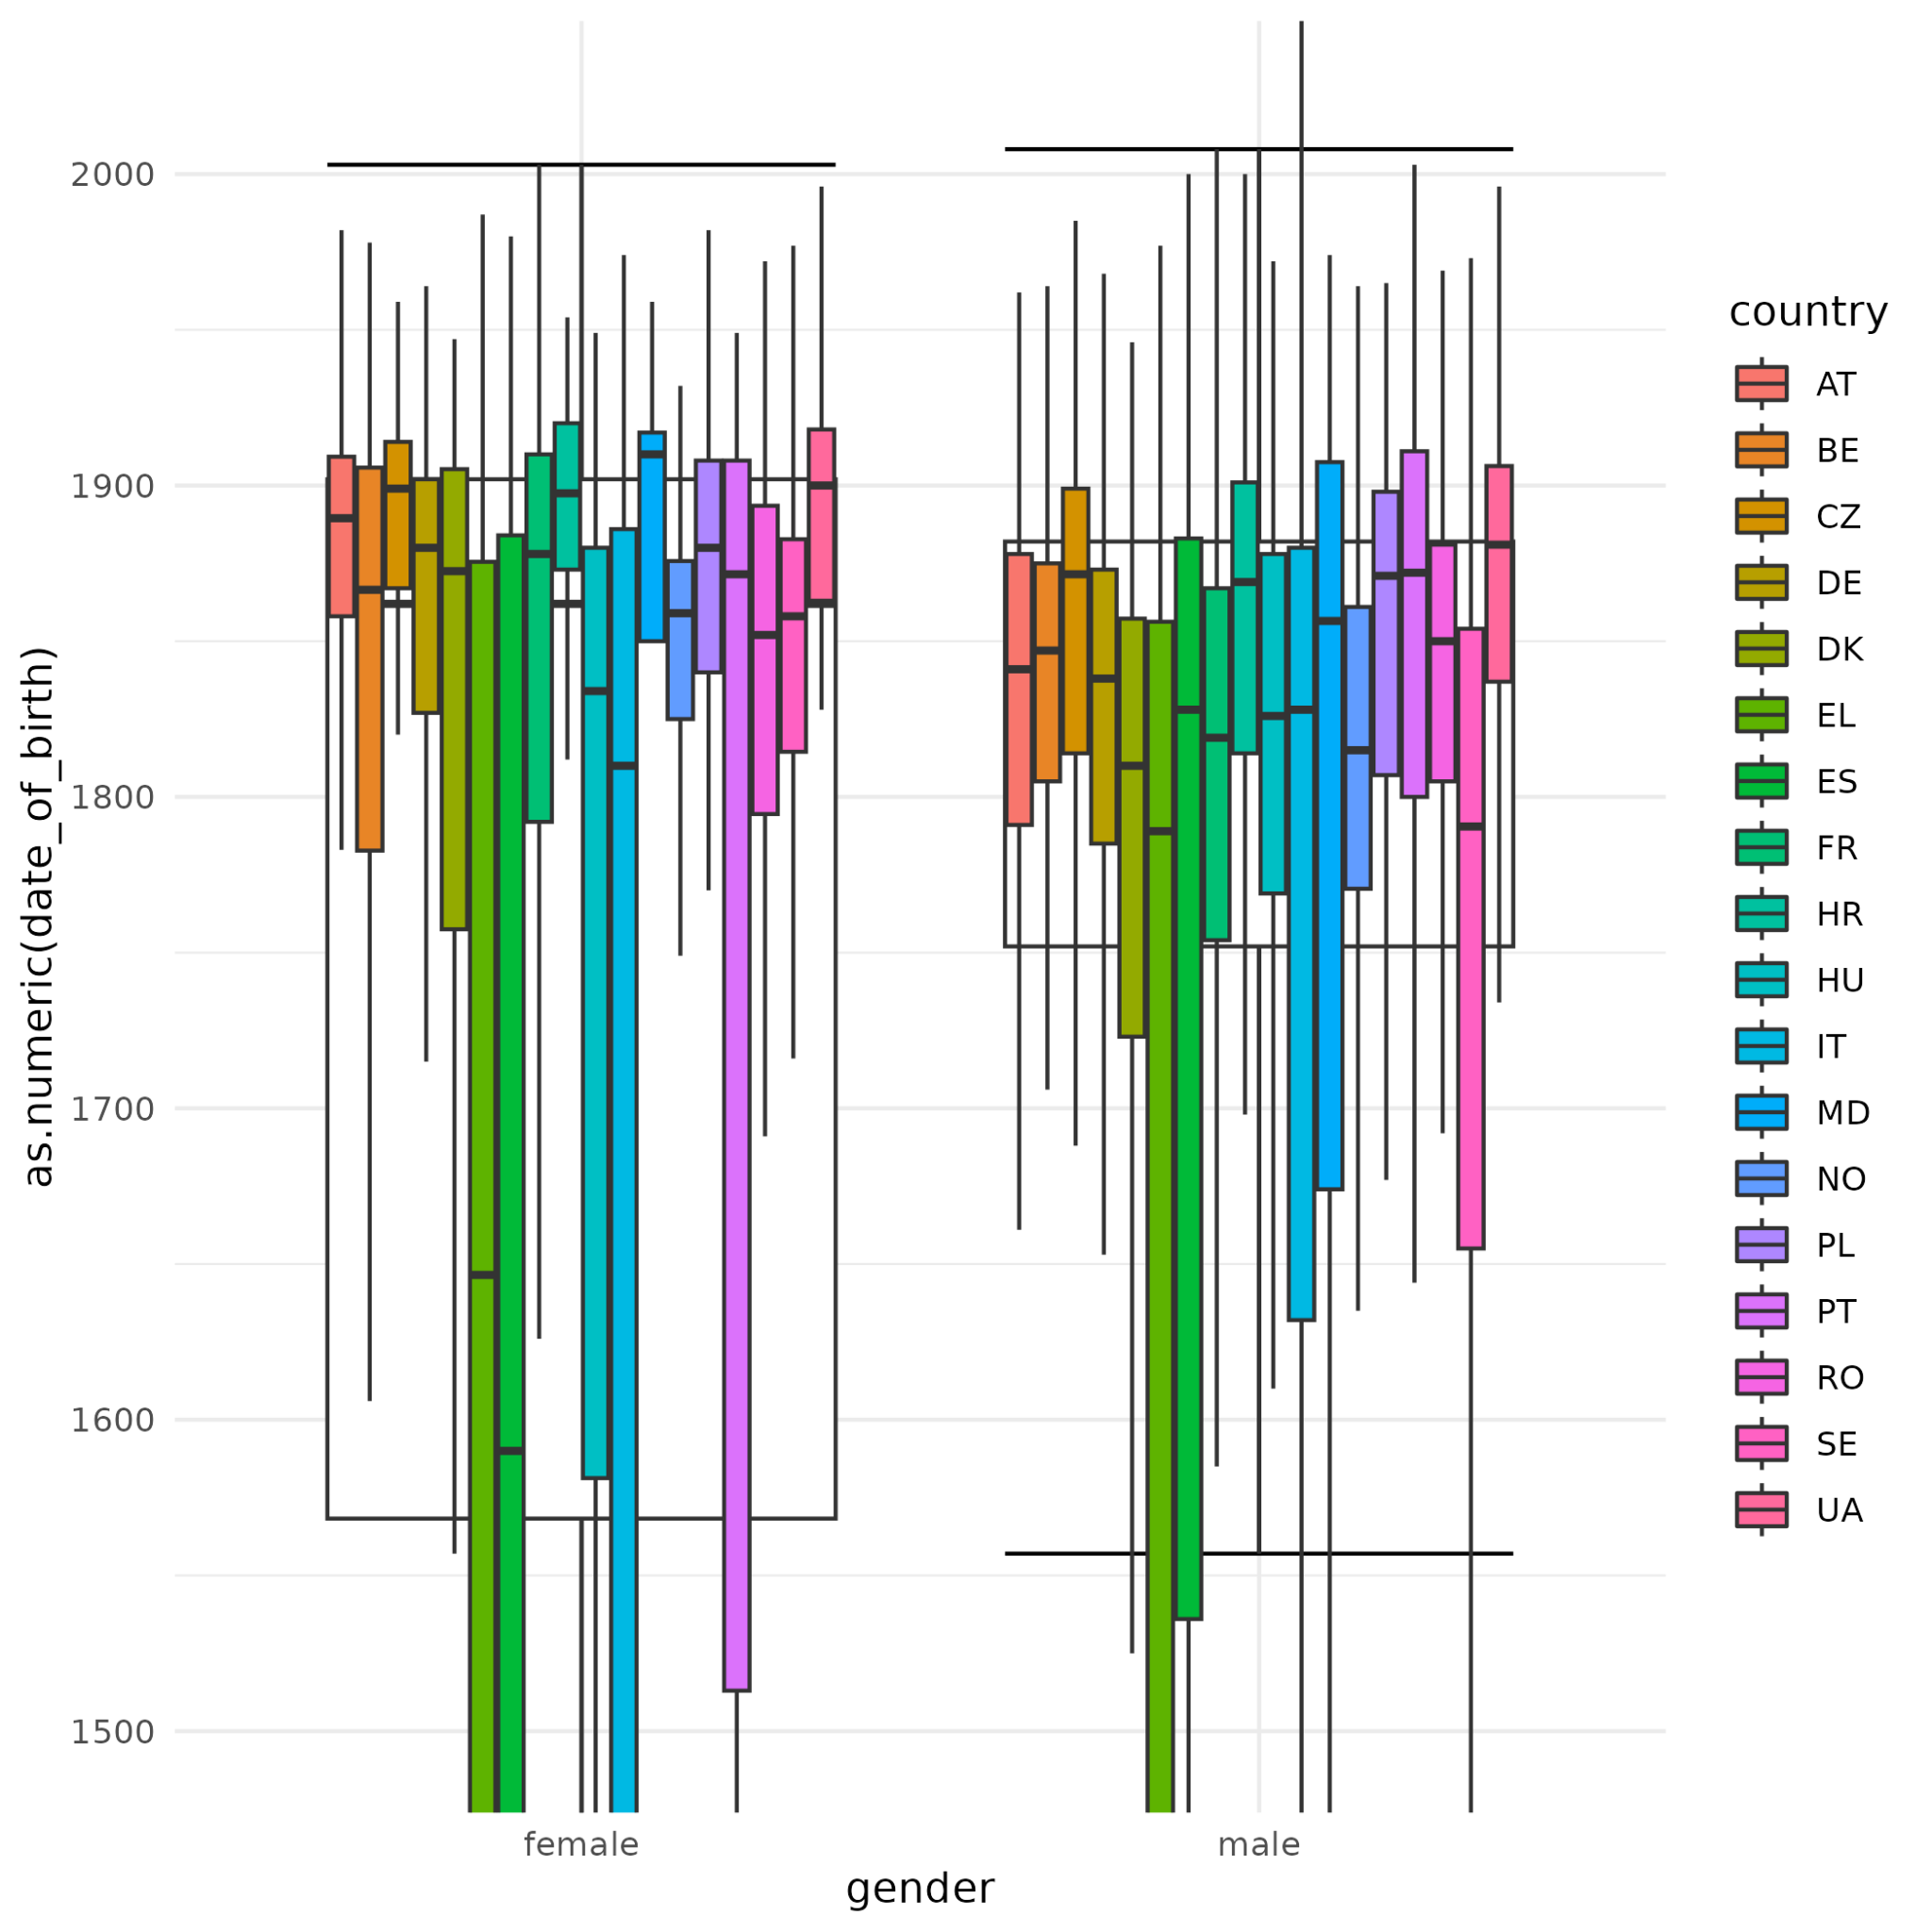

Slide 13
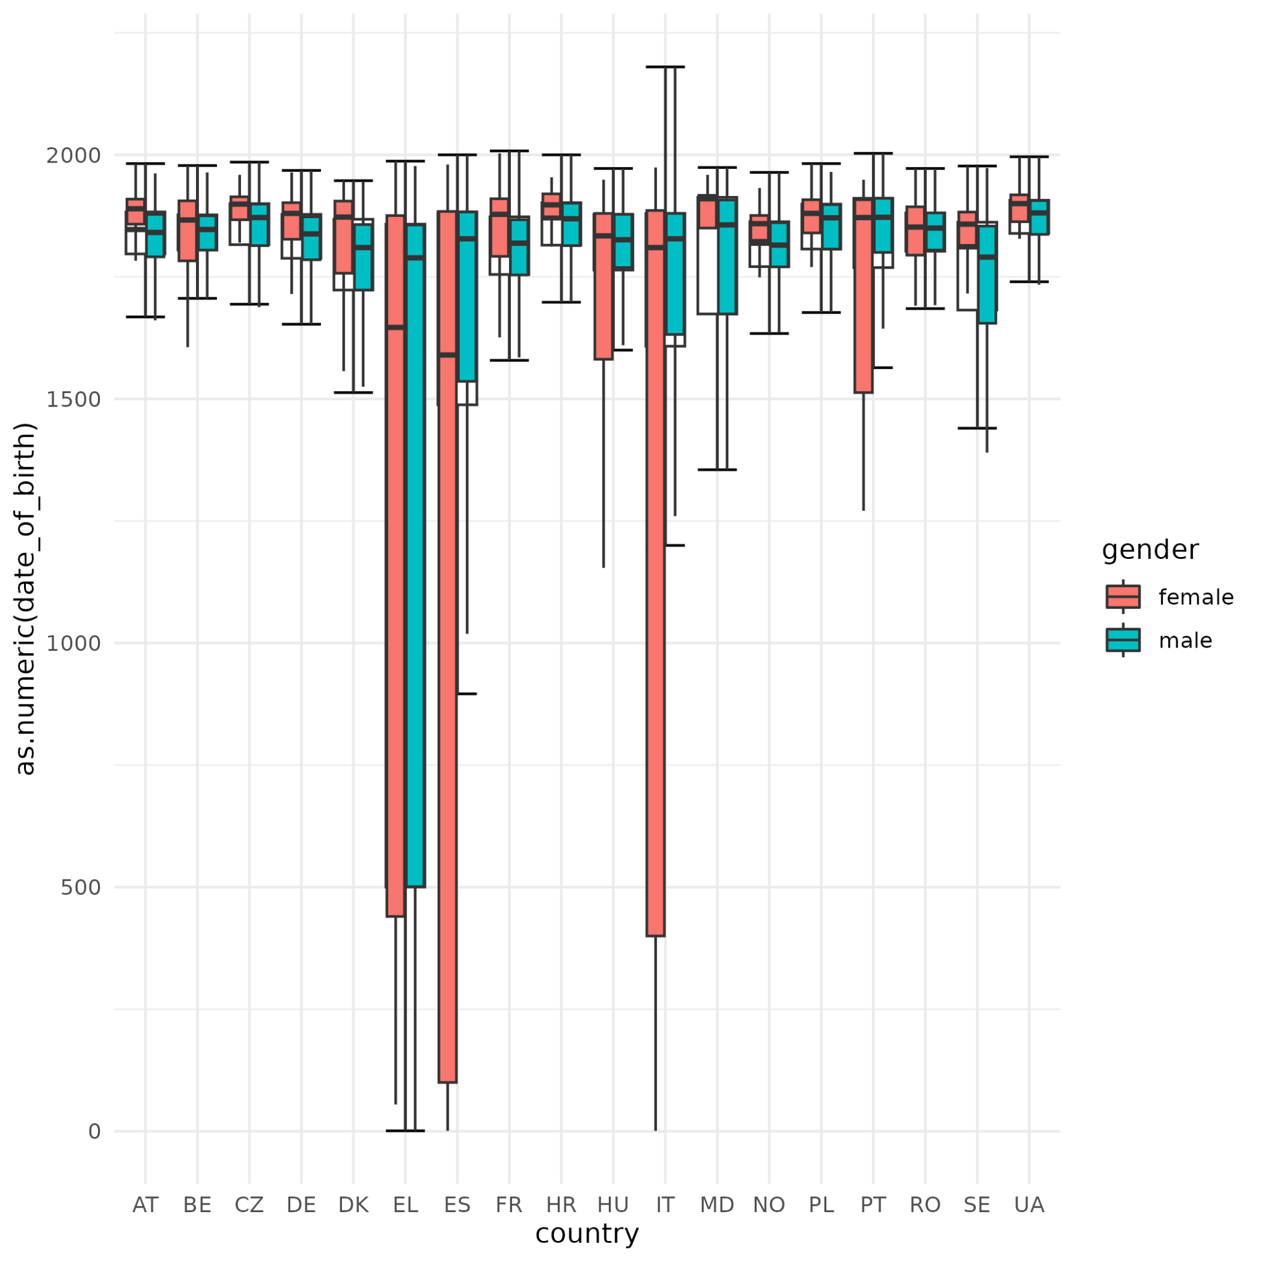
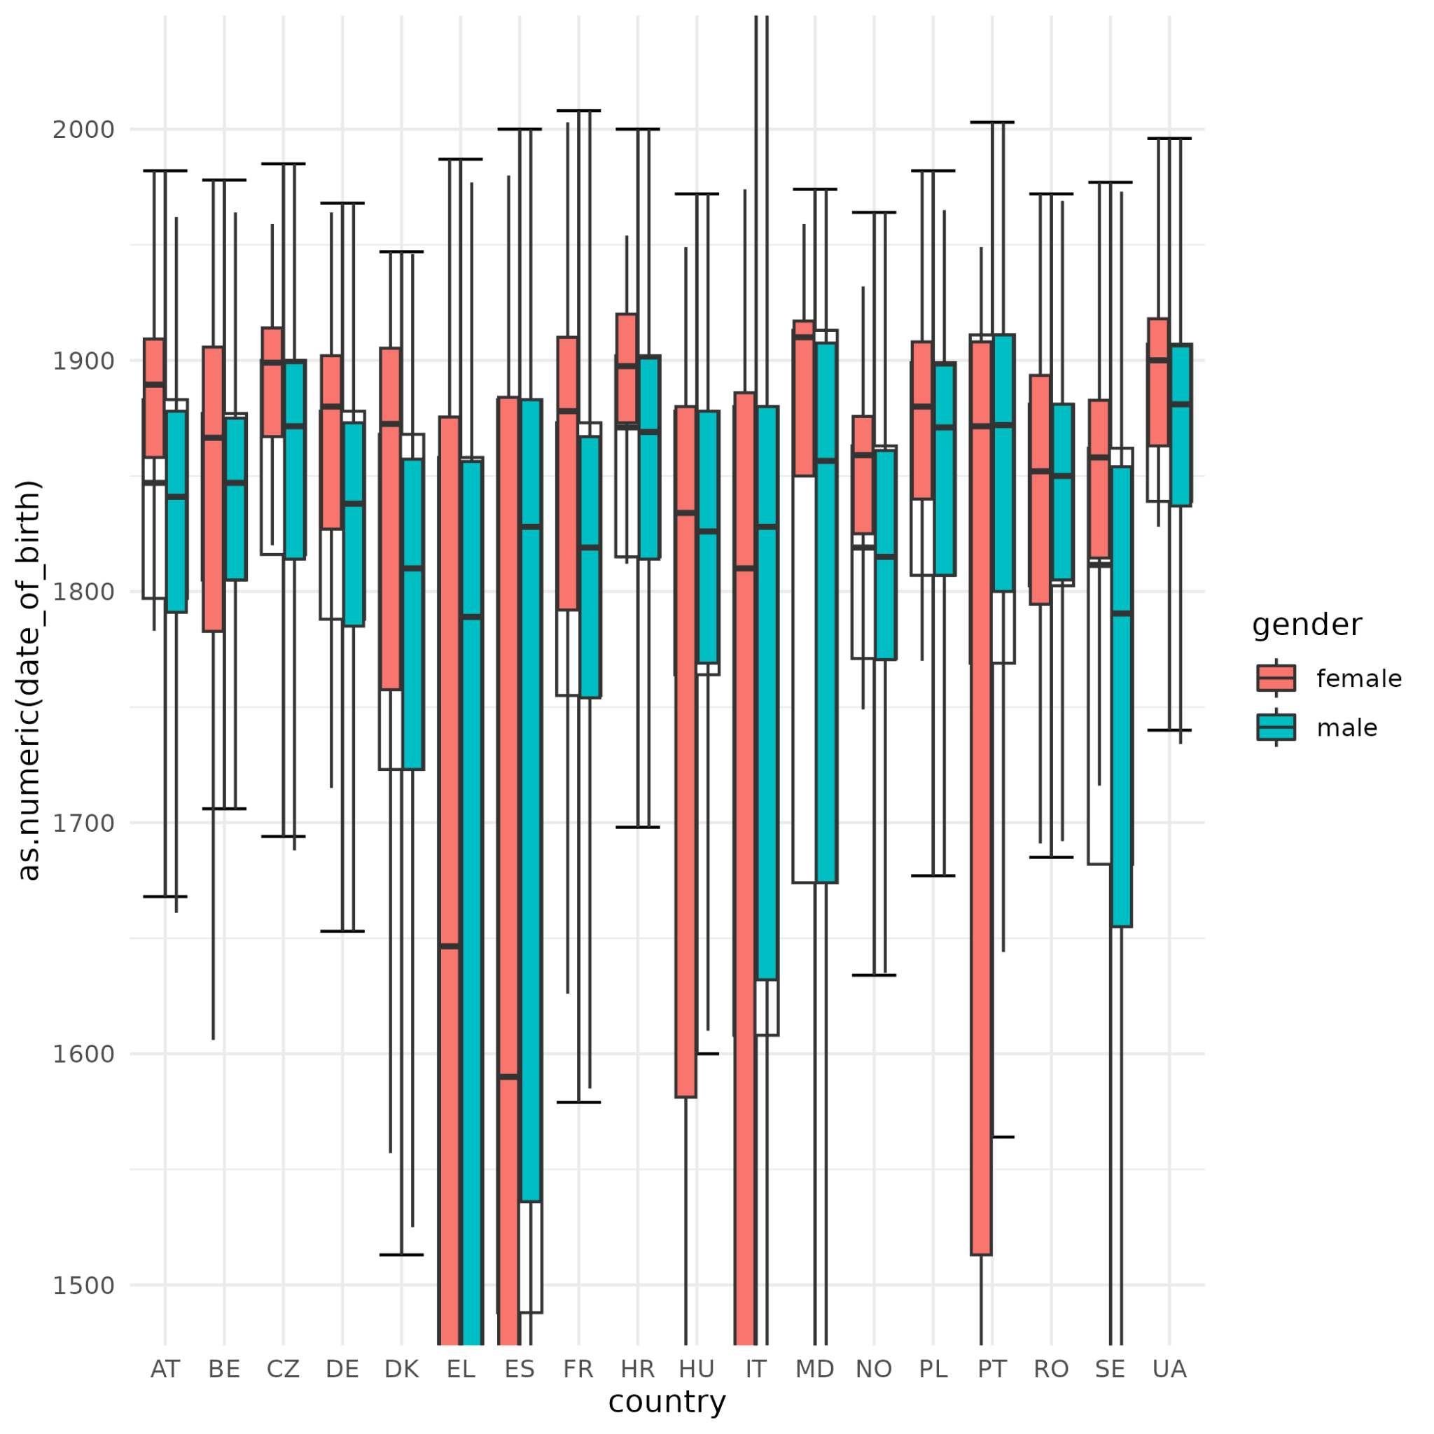

Slide 14
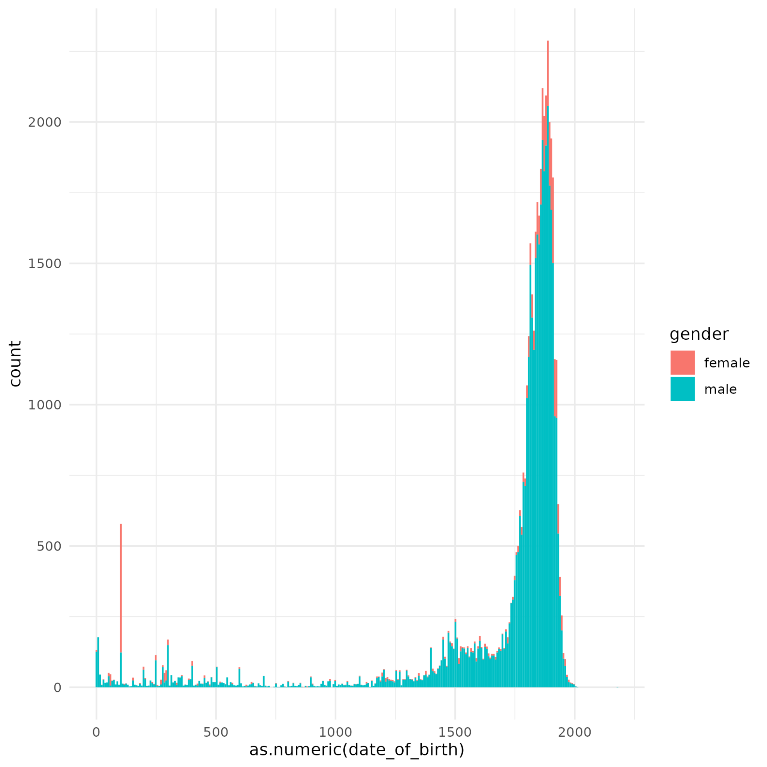
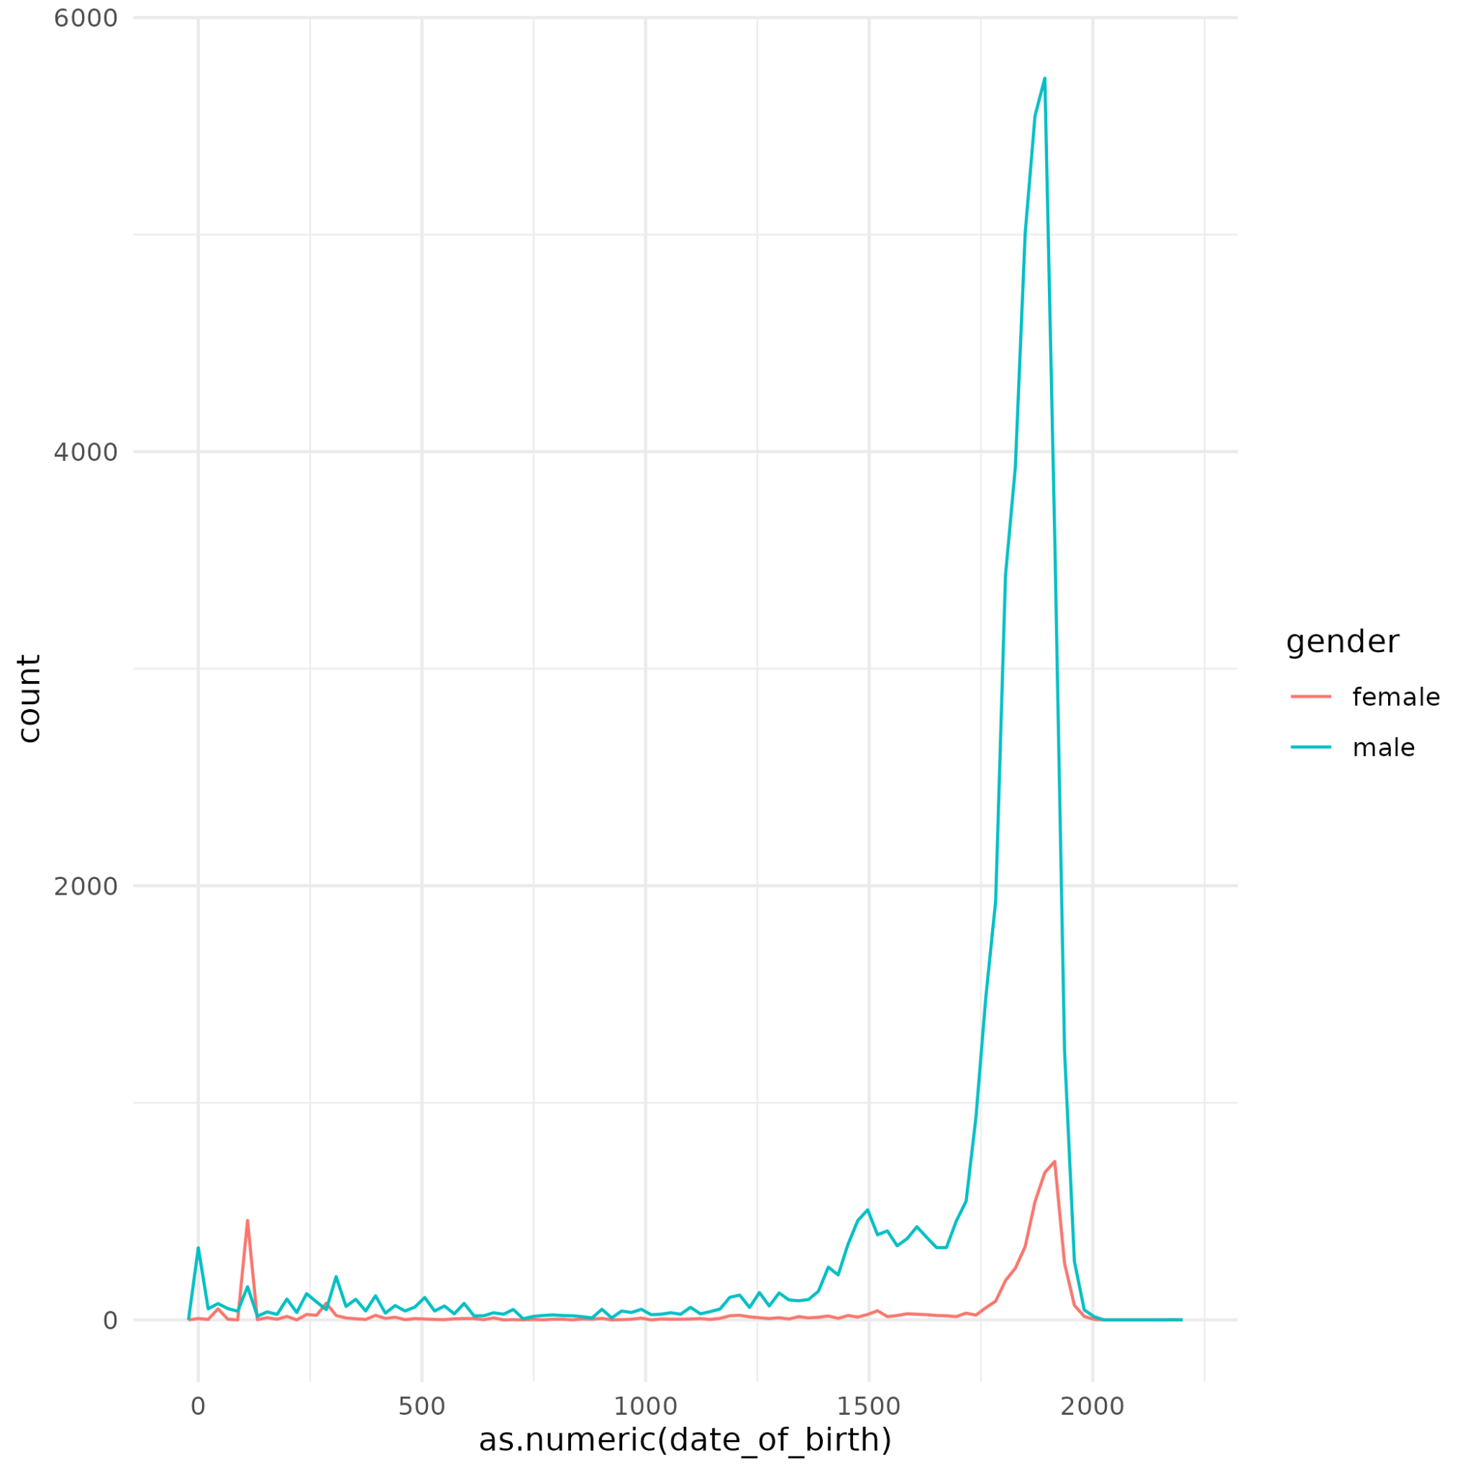

Slide 15
Conclusions
A vastly larger number of streets named after men.
Although there are outliers, the majority of female street names are named after more recently born people.
There are no countries with a substantial or majority amount of female names, however some of the countries with proportionally higher amounts include Spain and Germany.

Slide 16
Further steps
Zoom into the city data.
Analyze other demographics (ethnicity, sexuality, economic status, etc.)
Analyze a larger variety of countries.
Compare stats between continents.

Slide 17
Thank you!

